Slide 1

PROGRAMMING POE PART 3
Student Number:ST10450572
Name: Thuto Hlatshwayo
Module Code: PROG6212
Note:
This presentation covers the final phase of my POE for PROG6212.
I will show how Part 3 improved the system based on Part 2 feedback, discuss new features, and demonstrate the final design and implementation.

Slide 2

Overview of Part 3 Deliverables
What Part 3 Required:
Implement enhancements requested in Part 2 feedback.
Improve system design, validation, security, workflows, and UI.
Add new features such as reporting, CSV export, user management, and proper role authorization.
Produce architecture diagrams and final documentation.
Speaker Notes:
Part 3 builds on the previous phase and completes the system into a functional prototype.
The enhancements focused on making the system reliable and production-ready.

Slide 3
Lecturer Feedback From Part 2
Feedback Received From Lecturer:
Hourly rate must allow values above 500
In Part 2 the hourly rate was manually entered and restricted.
For Part 3, the lecturer requested that the hourly rate should now be assigned from the user profile automatically and not entered on the claim form.
Document list display must be improved
Long filenames caused the table layout to break.
Instead of showing the full filename, the system must show a Download / View Document button.
Coordinator & Manager Views must be cleaned up
Remove the text showing document names.
Replace with a single button such as “View Supporting Documents” to avoid layout distortion.
General UI improvement for document handling
The documents section must be compact, consistent, and easy to navigate.

Slide 4
Speaker notes:
My lecturer pointed out that the hourly rate could be above 500, so in Part 3 I removed the input field entirely and now the rate is assigned directly from the user profile.
They also highlighted layout issues caused by long document names, so I replaced filenames with a clean “Download Document” button.
The Coordinator and Manager review pages were updated so they no longer show long filenames — they now display a button only.
These changes improved consistency, layout stability, and made the system more user-friendly and professional.

Slide 5

Implemented Improvements in Part 3
1. Hourly Rate Now Auto-Assigned From User Profile
What I changed:
Removed the hourly rate input field from the lecturer’s claim form.
The system now fetches the hourly rate from the logged-in lecturer’s profile:
  var userId = int.Parse(User.FindFirstValue(ClaimTypes.NameIdentifier));
  var user = await _db.Users.FindAsync(userId);
  claim.HourlyRate = user.HourlyRate; // Auto-assigned
  claim.LecturerName = user.FullName;
  claim.LecturerId = user.UserId;
Impact:
Eliminates incorrect manual inputs
Ensures all calculations are consistent
Supports hourly rates above 500 as requested

Slide 6
2. Replaced Long Document Filenames With a “Download” Button
What I changed:
Removed the document names from the view
Added a compact View / Download button that prevents layout distortion
Code Snippet (Coordinator/Manager View):
<a asp-controller="Coordinator"
asp-action="DownloadDocument"
asp-route-documentId="@doc.DocumentId"
class="btn btn-sm btn-outline-primary">
View Document
</a>
Impact:
Long filenames no longer break the table layout
Clean, uniform look
More user-friendly interface

Slide 7

3. Cleaner Coordinator & Manager Interfaces
What I changed:
Consolidated document listings into a single “View Documents” column
Removed unnecessary text
Updated layout spacing and formatting
Result:
Tables are cleaner and readable
Review process is faster and visually consistent
Matches the UX recommendations from lecturer feedback

Slide 8
4. System-Wide UI/UX Improvements
Updated navigation links for HR Reports
Ensured consistent button style across all roles
Added validation and improved TempData notification messages
Strengthened security by ensuring role-based access on all new features

Slide 9
Speaker Notes :
“In Part 3, I addressed all lecturer feedback. The hourly rate now auto-loads from the profile, meaning lecturers cannot enter incorrect values. I redesigned how documents appear by replacing long names with a clean download button. The coordinator and manager views were also improved to avoid layout breakage. These changes make the system more professional, consistent, and aligned with user experience expectations.”

Slide 10
Design & Technical Decisions
. Role-Based Access Control (RBAC)
To prevent unauthorized access and ensure clean separation of responsibilities, the system uses ASP.NET Core’s [Authorize(Roles = "…")] attributes.
Each controller is restricted to its specific role:
Image provided on the next page:

Slide 11
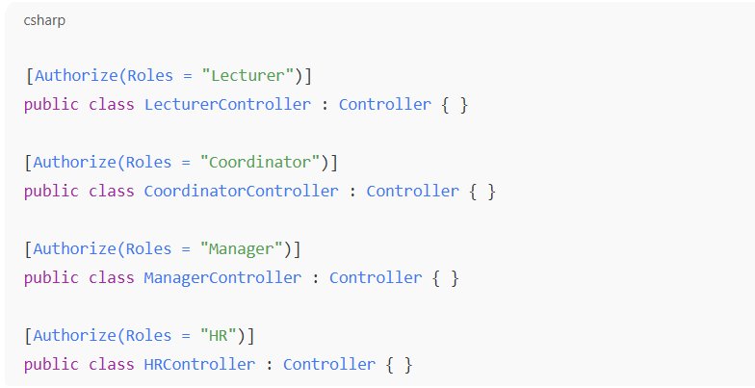

Slide 12
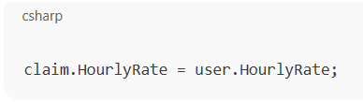
Hourly Rate Stored in User Profile
Instead of letting lecturers manually type any hourly rate (which could exceed R500), the rate is now assigned during HR user creation and preloaded automatically when a lecturer starts a claim.

Slide 13
CSV Export Instead of PDF
To improve compatibility and meet assignment requirements, HR users now export reports as CSV:
return File(bytes, "text/csv", "claims_report.csv");
Why CSV?
✔ Opens in Excel without extra libraries
✔ Easier to mark, grade, analyze
✔ Avoids PDF font-loading issues

Slide 14
Improved Database Schema With Decimal Precision
To ensure correct financial calculations, EF Core decimal precision was explicitly defined:
modelBuilder.Entity<Claim>()
.Property(c => c.HourlyRate)
.HasColumnType("decimal(10,2)");
Why this matters:
✔ Guarantees consistent money formatting
✔ Prevents rounding errors
✔ Required for accurate totals on all reports

Slide 15
Key Feature 1: Role-Based Dashboards
What was added:
Each role sees different options:
  Lecturer: Submit & track claims
  Coordinator: Review lecturer claims
  Manager: Approve final claims
  HR: Manage users & export reports
Code Explained (High-level):
@if (User.IsInRole("Coordinator")) {
<a asp-controller="Admin" asp-action="CoordinatorView">Coordinator Dashboard</a>
}
Speaker Notes:
NAVBAR dynamically hides/shows options based on role.
Resolves major confusion from Part 2.

Slide 16
Key Feature 2: Lecturer Claim Submission
What improved:
Better form validation
Decimal accuracy
Uploading supporting documents
Automatic claim status set to Pending Coordinator
Speaker Notes:
Claim accuracy was a major part of the lecturer’s feedback.
Validation ensures no empty or invalid values can be submitted.

Slide 17
Key Feature 3: Claim Review Workflow
Workflow Implemented:
Lecturer submits
Coordinator reviews → Approve/Decline
Manager reviews → Approve/Decline
HR finalises and exports
Speaker Notes:
This workflow mirrors real institutions’ claim systems.
Every approval updates the database.

Slide 18

Key Feature 4: HR User Management
HR Can:
Create users
Edit details
Delete users
Assign roles
Update hourly rate
Export reports
Speaker Notes:
HR module is fully functional and secure.

Slide 19
Key Feature 5: CSV Report Generation
Why CSV Instead of PDF:
Tutor feedback advised against PDFSharp issues.
CSV works on all devices.
Opens in Excel without formatting problems.
CSV Export Code Explained:
return File(bytes, "text/csv", "claims_report.csv");
Speaker Notes:
CSV allows HR to sort, filter, and manipulate claim data easily.

Slide 20

UI & Navigation Improvements
Enhancements:
Consistent Bootstrap styling
Buttons reorganized
Role-based navigation
Fixed the Coordinator view button that wasn't working
Clean layout for claim lists and user lists
Speaker Notes:
These changes improve usability and overall flow.

Slide 21
Testing & Debugging Completed
Included tests:
Login validation
Role blocking
Submitting multiple claims
CSV export
Editing/deleting users
Handling missing documents
Database migrations
Navigation tests (all links fixed)
Speaker Notes:
System tested end-to-end by simulating each role.

Slide 22
Final System Demo
Speaker Notes:
Demonstrate:
Lecturer claim submission
Coordinator approval
Manager approval
HR user management
CSV export

Slide 23
Video of completed assignment
https://youtu.be/0AaM3fSU19U

Slide 24
GitHub Repository link and YouTube video link
https://github.com/HlatshwayoThuto/Prog6212-POE-Part3.git
https://youtu.be/0AaM3fSU19U

